Slide 1
GOES-19 L2 (Group 6) Provisional Validation
Peer/Stakeholder Product Validation Review (PS-PVR)
March 12, 2025
NWS Perspective: AWIPS verification
Derek Van Pelt/TOWR-S Team
TOWR-S team, NWS Office of Observations

Slide 2
Products Evaluated
All imagery from March 06, 2025
Aerosol Optical Depth (FD,COUNS, MESOs)
Dust Detection (FD,COINS, MESOs)
Smoke Detection (FD,COUNS, MESOs)
Radiation budget products not included in AWIPS

Slide 3
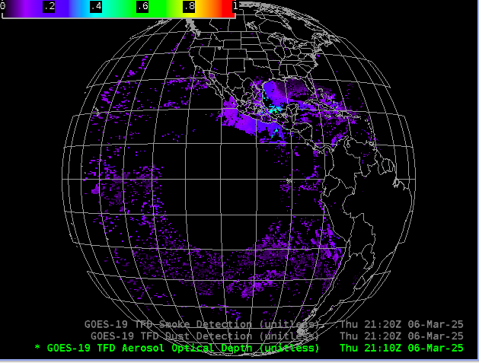
Aerosol Optical Depth
GOES-19 Preliminary, Non-Operational Data

Slide 4
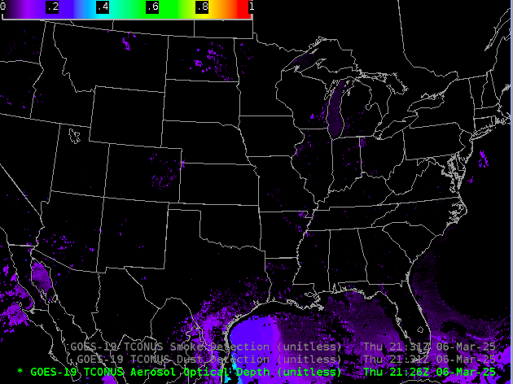
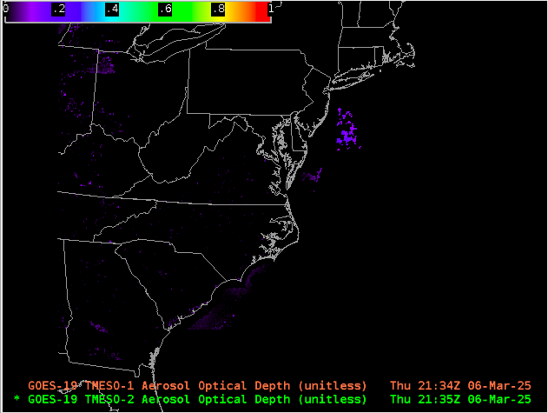
Aerosol Optical Depth
GOES-19 Preliminary, Non-Operational Data
GOES-19 Preliminary, Non-Operational Data

Slide 5
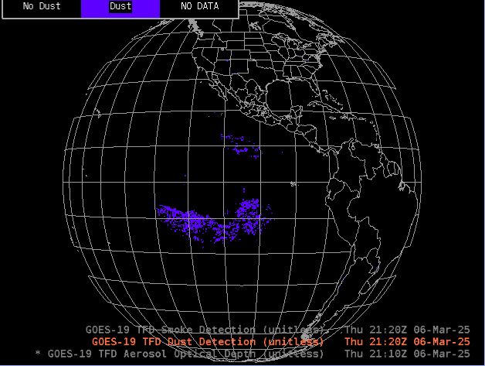
Dust Detection
GOES-19 Preliminary, Non-Operational Data

Slide 6
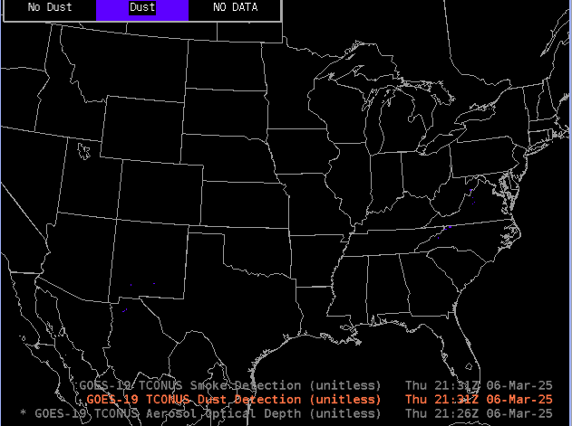
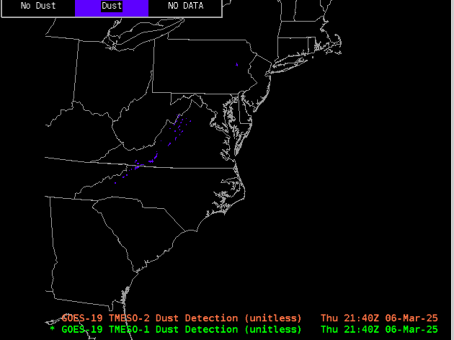
Dust Detection
GOES-19 Preliminary, Non-Operational Data
GOES-19 Preliminary, Non-Operational Data

Slide 7
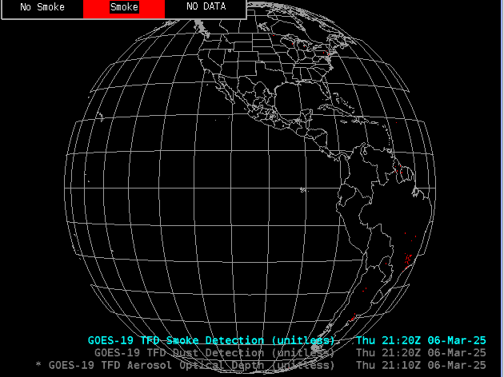
Smoke Detection
GOES-19 Preliminary, Non-Operational Data

Slide 8
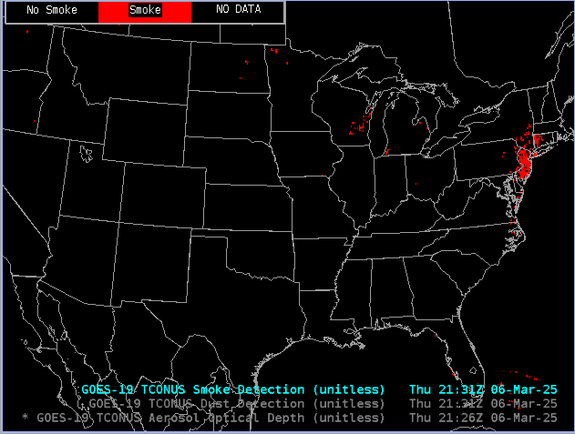
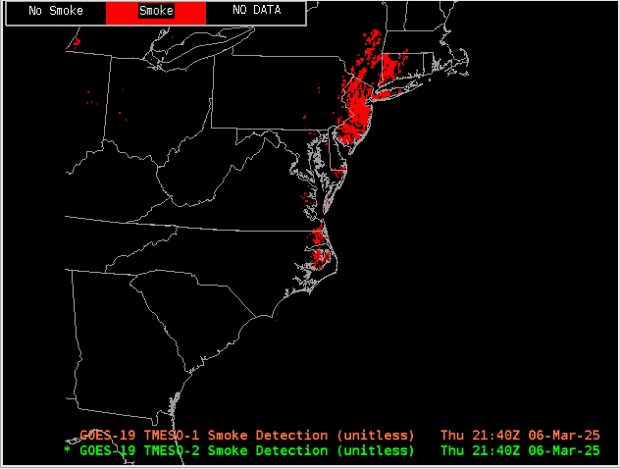
Smoke Detection
GOES-19 Preliminary, Non-Operational Data
GOES-19 Preliminary, Non-Operational Data

Slide 9
Notes
AWIPS ingests and displays all these products using its baseline configurations.
No fielding issues are expected
G-19 products conform closely to G-16,17 conventions (GOES-R Product User Guide)
AWIPS’ baseline configurations for G16 and G18 are extensible for G19+

